Slide 1
Preparing Students for a Subsequent Diagnostic
Diagnostic
The most important thing you can do to get accurate data is to motivate students to put forth their best effort on the i-Ready Diagnostic. Before administering a subsequent Diagnostic, use the following resources to energize students, review expectations, and set goals. In this document, you will find four PowerPoint® presentations to prepare your students for a subsequent Diagnostic. See below to locate your grade-level presentation.
Presentations Included:
Tips:
Internalize the presentation by reviewing it ahead of time.
Show this presentation the day of or a day before the Diagnostic.
Schedule time for the presentation.
Check in with students for understanding along the way.
End the presentation by asking students what strategies they want to use.
Optional slides: These slides are not required but encouraged.
Incentive slide: Edit the PowerPoint to include any class, school, or individual incentives.
To preview universal accessibility features with students, show slides 2-5.
Embedded Universal Supports (Grades K–8)
Grades 6–8
PowerPoint® is a registered trademark of Microsoft Corporation.

Slide 2
Embedded Universal Supports
Grades K–8

Slide 3
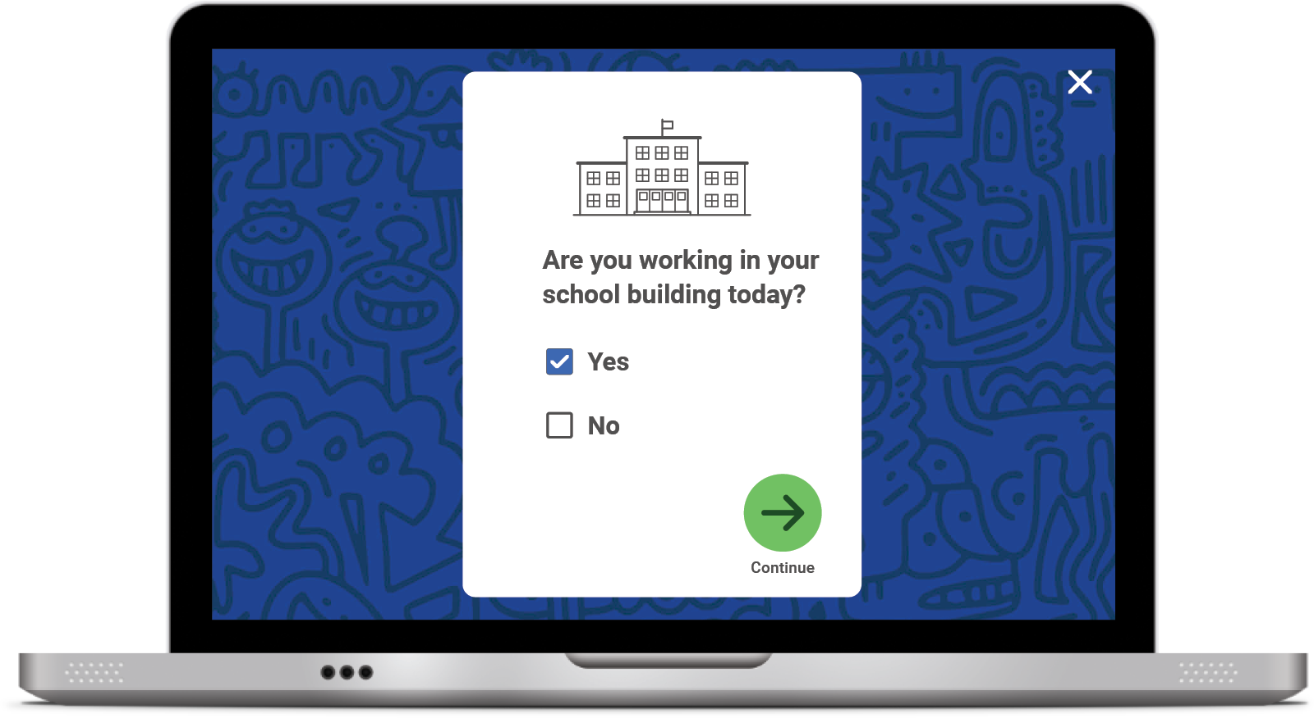
Keyboard Navigation
How: Using specific keyboard selections:
Tab, Shift + Tab, and Enter or Space
A box will appear showing where you are on the screen.
The Tab key will initiate keyboard navigation features.

Slide 4
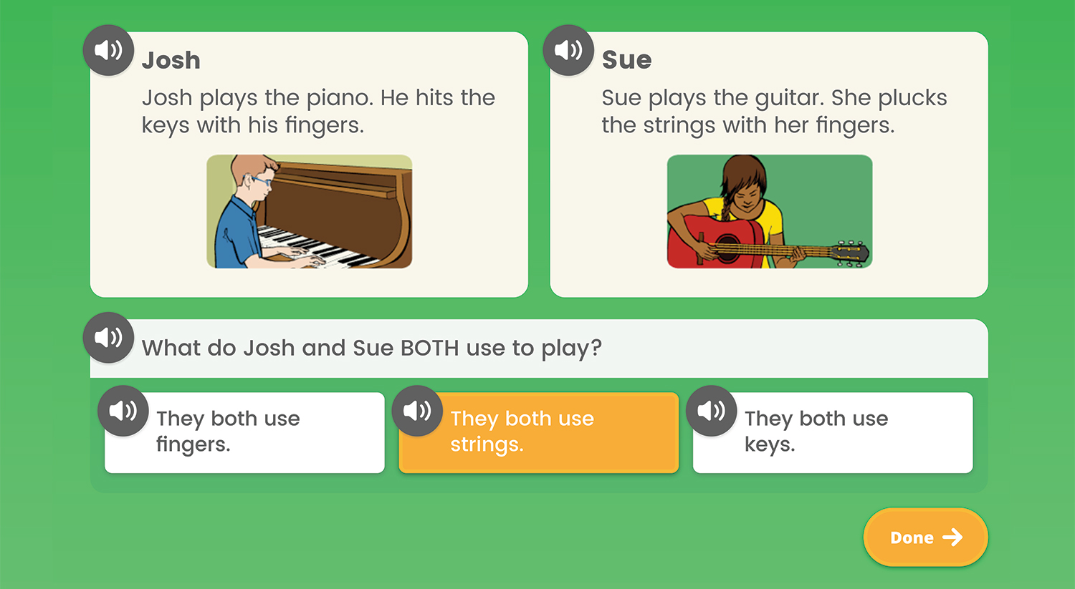
Audio Support
How: Using the speaker icon, wherever it appears
Notes:
Audio support is currently available for Diagnostic items at these levels:
Mathematics: Grades K–5
Phonics: Grades K–3
High-Frequency Words: Grades K–3
Vocabulary: Grades K–2
Phonological Awareness: Grades K–1
Reading Comprehension: Grade K
What: Provides the ability to click on an audio button (speaker icon) to have the corresponding text for a question and/or answer read aloud
Where: For select items in the Diagnostic, based on the domain and/or level of the items

Slide 5
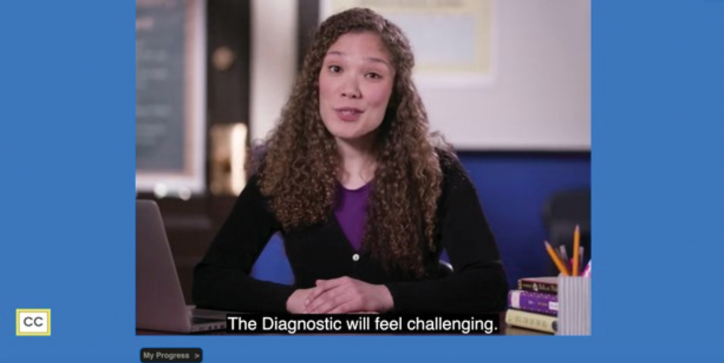
Closed Captioning
How: Using the CC box in the bottom left corner of the screen
Clicking the CC box allows you to view the text on screen.
Notes:
What: Provides the ability to display text on the computer screen that aligns to the audio
Where: In Diagnostic Introductory Videos for Grades 3+ when viewed through the student-facing Diagnostic assessment screen. Closed captioning is not available for test items at this time.

Slide 6
Get Ready to Take the Diagnostic
Grades 6–8

Slide 7
What We Will Cover
Things to Know
Tips
What to Expect
Let’s Remember
Introduction Videos

Slide 8
“Why are we taking the i-Ready Diagnostic?”

Slide 9
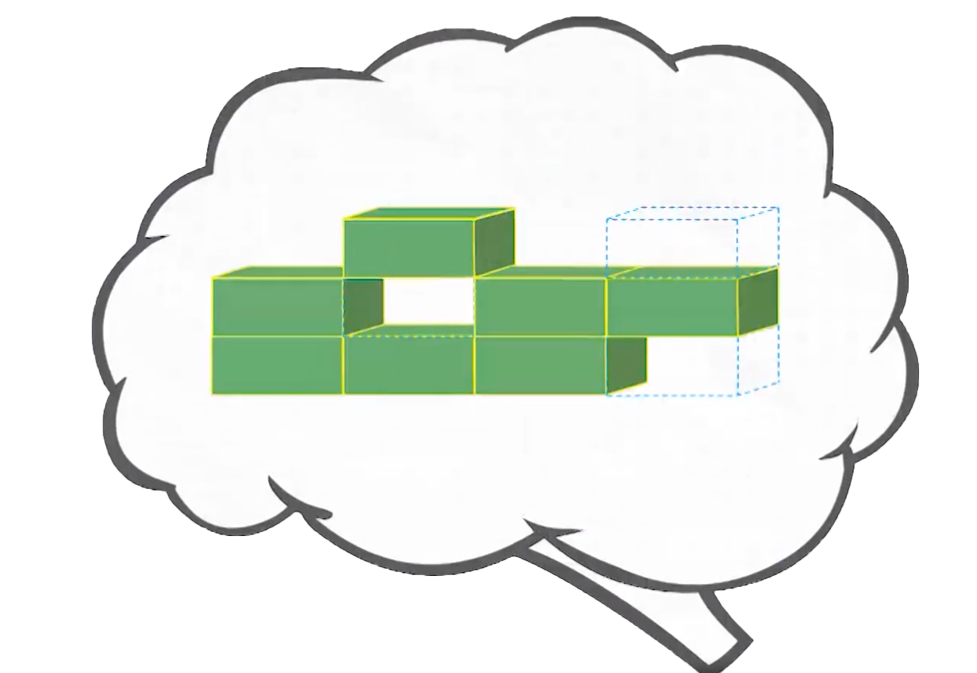
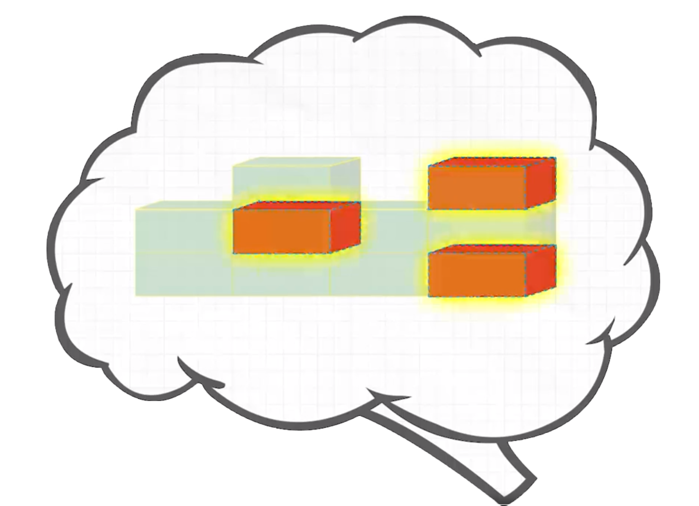
Remember, the Diagnostic Is Important Because It Helps You and Your Teachers . . .
Understand what you already know
and what you need to learn
Notes:
Today, when you complete your Diagnostic, you will see a score pop up on your screen. This score is one of many that you will see on your Diagnostic report. Your Diagnostic report will help us see the areas where you have strengths and the areas where we can help you grow. We will talk about your Diagnostic report and your personal learning goals when we meet for our Data Chat.

Slide 10
Why Are We Taking This Again?
Taking the next Diagnostic helps us:
Celebrate what you learned
Know your progress toward goals
Learn how much you need to know before the end of the year
Get new lessons that are just right for you

Slide 11
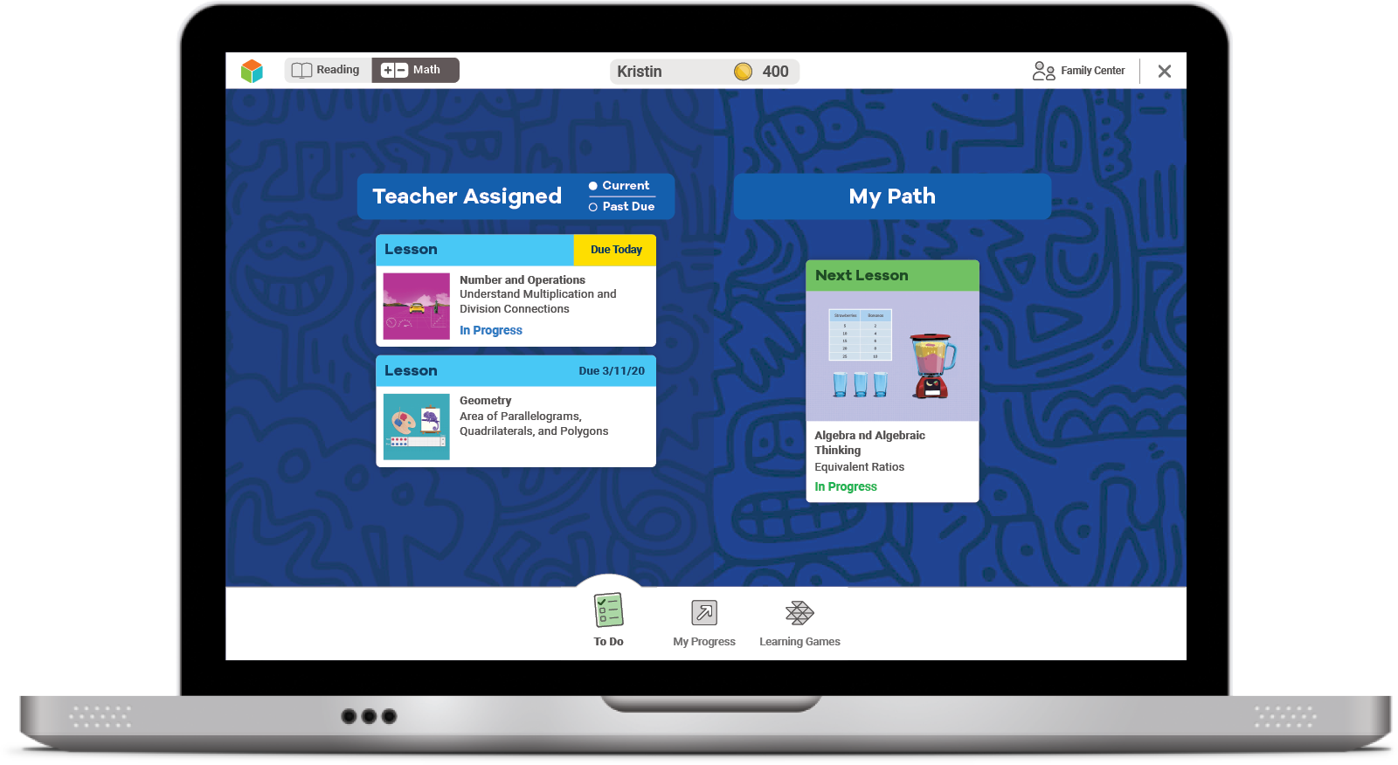
Online Lessons
If you try your best on the Diagnostic, lessons will match what you need to learn.
The results of your Diagnostic decide what lessons you will get.

Slide 12
Talk about How We Take the Diagnostic
Something I did well was . . .
I can work on . . .

Slide 13
How does the Diagnostic work?
i-Ready is an adaptive test. This means the questions change based on your answers.
Some questions will be . . .
HARD
EASY
JUST RIGHT

Slide 14
What should you do?
Remember this test is adaptive! You should try your best, but know that you'll get questions you don't know how to answer.

Slide 15
What should you do?
Try your best. Do not rush, but do not spend too much time on any one question.

Slide 16
What should you do?
You will see questions you won’t know how to answer because you haven’t learned them yet. That is okay! Choose the best answer and move on.
Too Hard
Too Easy
Just Right

Slide 17
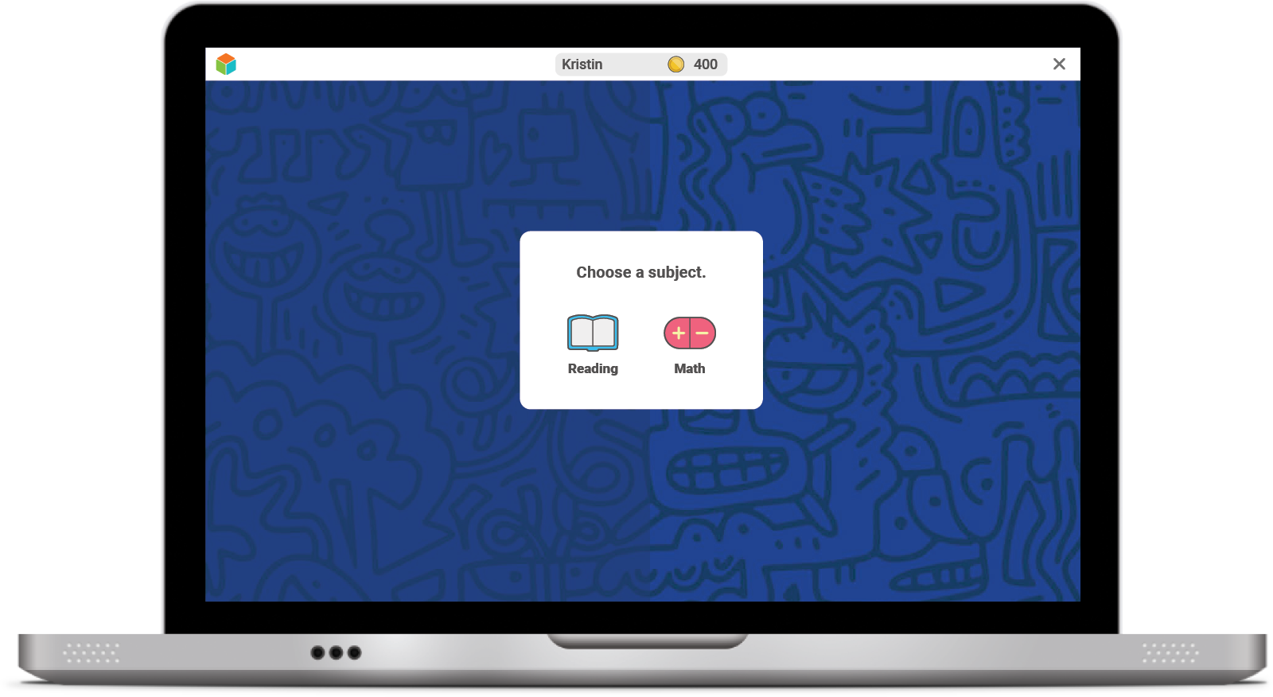
Once you log in, you will see this:

Slide 18
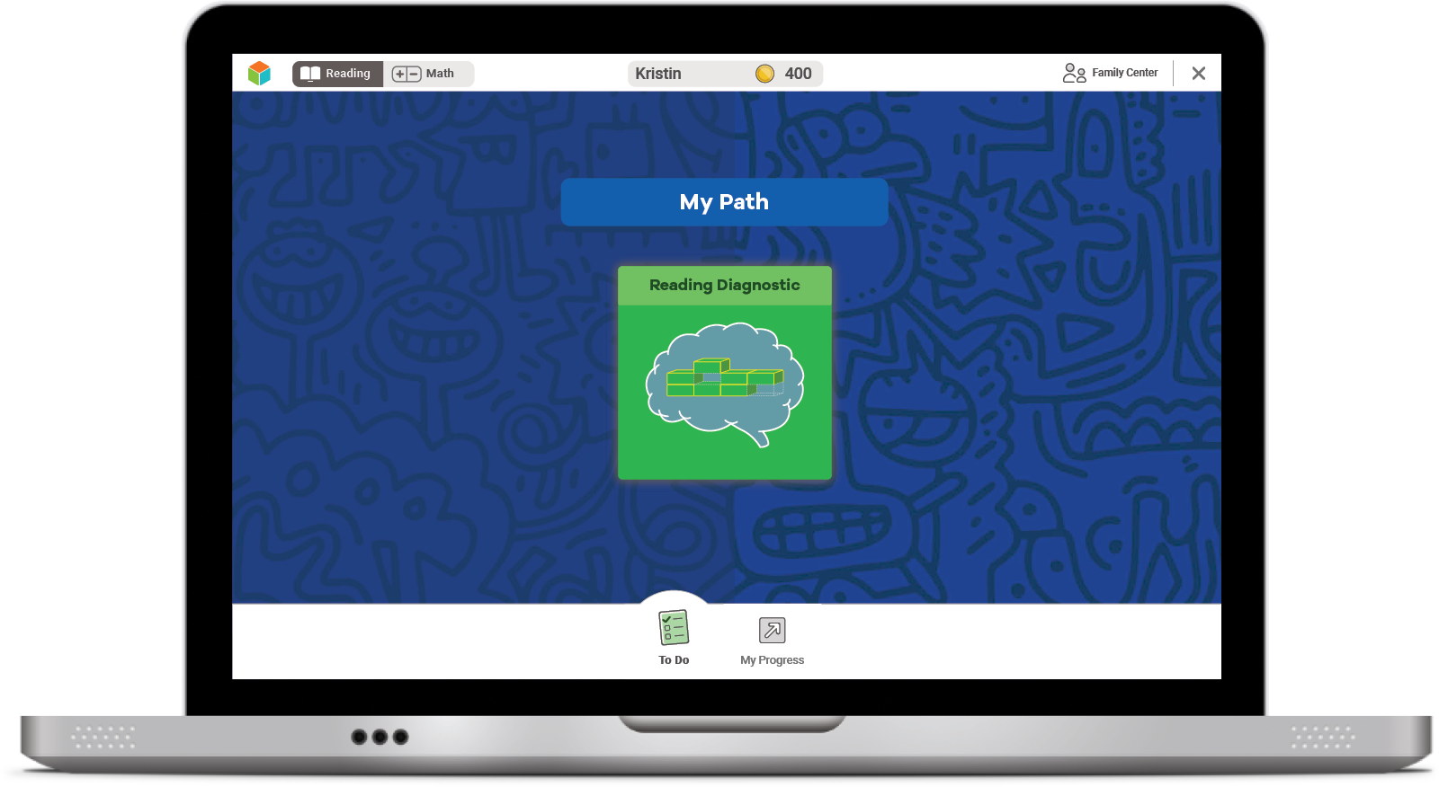
Next, you will see a page like this:
Select the green button to start your Diagnostic.

Slide 19
Next, you will:
Watch a video.

Slide 20
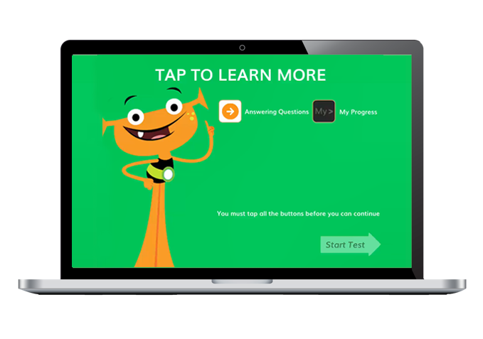
Next, you will:
Watch a video.
Click on each button to watch a video about each tool.

Slide 21
Next, you will:
Watch a video.
You must click on all of them before you can press start.

Slide 22
Student Survey
Once you START or RESUME your Diagnostic, you will see this question pop up on your screen:
Click No if you are taking the Diagnostic at HOME.
Click Yes if you are taking the Diagnostic at SCHOOL.
Click the green arrow to move on.

Slide 23
Optional
Introductory Demo Videos
MATH
READING

Slide 24
Helpful Tips
Take your time and do not rush.
Read each question and answer choice carefully.
If you get a question you have not learned yet, try your best.
For Math—Show your work on paper for every problem.
For Reading—Read each passage carefully, and reread the passage when necessary.
Check your work before going to the next question.

Slide 25
Our Plan
After the Diagnostic, i-Ready creates a special report for you and your family.

Slide 26
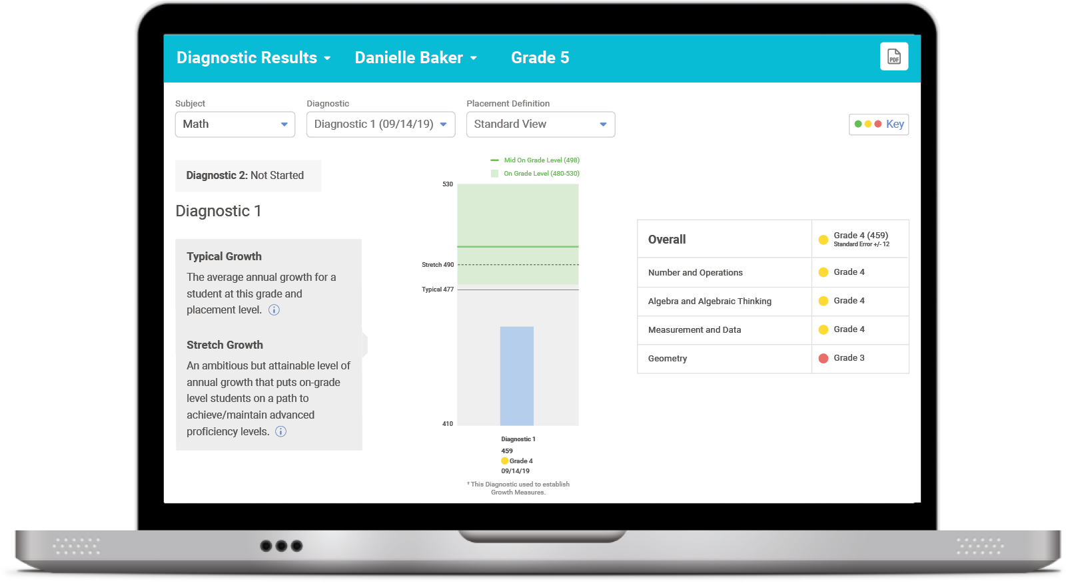
Our Plan
We can talk about:
Progress toward your growth goals
Your strengths and areas for growth
How you did
After the Diagnostic, we can review your results and goals.

Slide 27
Optional
Our Incentives
Notes:
For ideas from other educators, visit i-ReadyCentral.com/Ideas.

Slide 28
Reflections
Why is it important to try your best on the Diagnostic?
What strategies do you plan to use on your i-Ready Diagnostic?
What do you want to remember?

